Slide 1
Your uncle Dan owns an independent bookstore called Bookends in Seattle, Washington. You drop in to see him whenever you’re in the neighborhood to catch up and borrow some graphic novels. (That’s you in the picture.)
When you visit this time, Dan sits you down in a corner and tells you he needs help. “Sales are down,” he says, “and rent’s going up. It’s killing me. I’d say I’ve got six months to turn things around or I’m done. The end of Bookends. You still learning about marketing?—your mom said you’re taking a class. Got any bright ideas? Maybe some whiz-bang advertising?”—he grins and punches you lightly on the shoulder.
You start to tell him that marketing isn’t just advertising . . . but instead you say, “I don’t know, Dan. I’ll have to think about it.”

Slide 2
So, you do think about it. You don’t know everything about marketing yet, but you’ve learned this: Your uncle needs to understand his customers—that’s where marketing starts and ends. Who are Dan’s customers, and what’s up with them? Why aren’t they buying as much as they used to? How can you find out more about what they want?
These are big, important questions. For now, they all have one answer: marketing information and research.

Slide 3
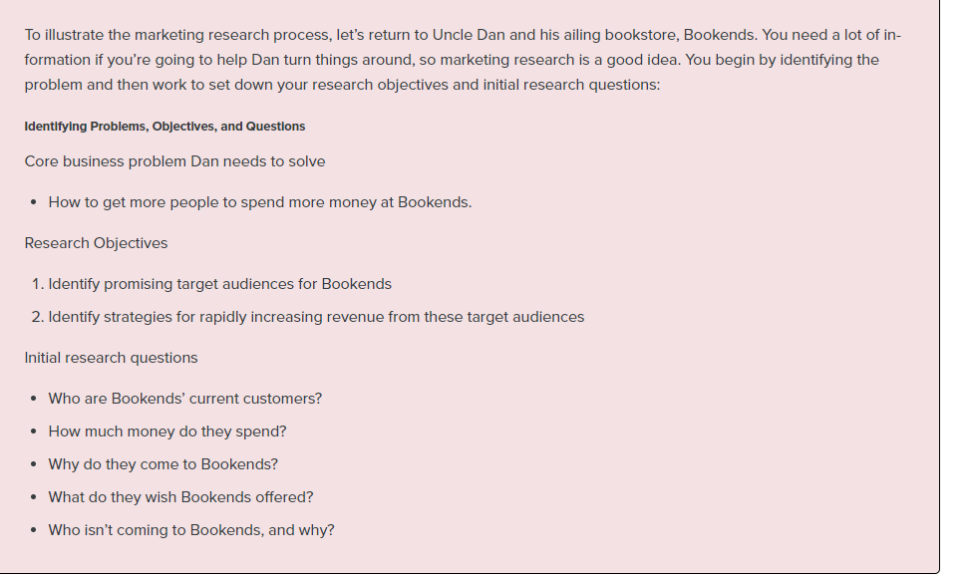
Step 1: Identify the Problem

Slide 4
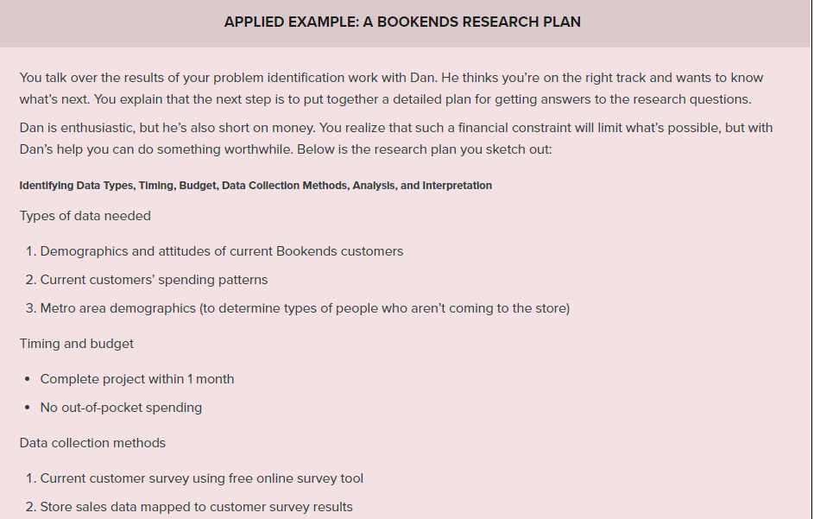
Step 2: Develop a Research Plan

Slide 5
